Slide 1
R
Cluster

Slide 2
Clustering methods are used to identify groups of similar objects in a multivariate data sets collected from fields such as marketing, bio-medical and geo-spatial. They are different types of clustering methods, including:

Slide 3
Partitioning methods
Hierarchical clustering
Fuzzy clustering
Density-based clustering
Model-based clustering

Slide 4
install.packages("factoextra") install.packages("cluster") install.packages("magrittr")

Slide 5
# Load and prepare the data
data("USArrests")
my_data <- USArrests %>%
na.omit() %>% # Remove missing values (NA)
scale() # Scale variables
# View the firt 3 rows
head(my_data, n = 3)
res.dist <- get_dist(USArrests, stand = TRUE, method = "pearson")
fviz_dist(res.dist,
gradient = list(low = "#00AFBB", mid = "white", high = "#FC4E07"))

Slide 6
Distance measures
The classification of objects, into clusters, requires some methods for measuring the distance or the (dis)similarity between the objects.
It’s simple to compute and visualize distance matrix using the functions get_dist() and fviz_dist() [factoextra R package]:
get_dist(): for computing a distance matrix between the rows of a data matrix. Compared to the standard dist()function, it supports correlation-based distance measures including “pearson”, “kendall” and “spearman” methods.
fviz_dist(): for visualizing a distance matrix

Slide 7
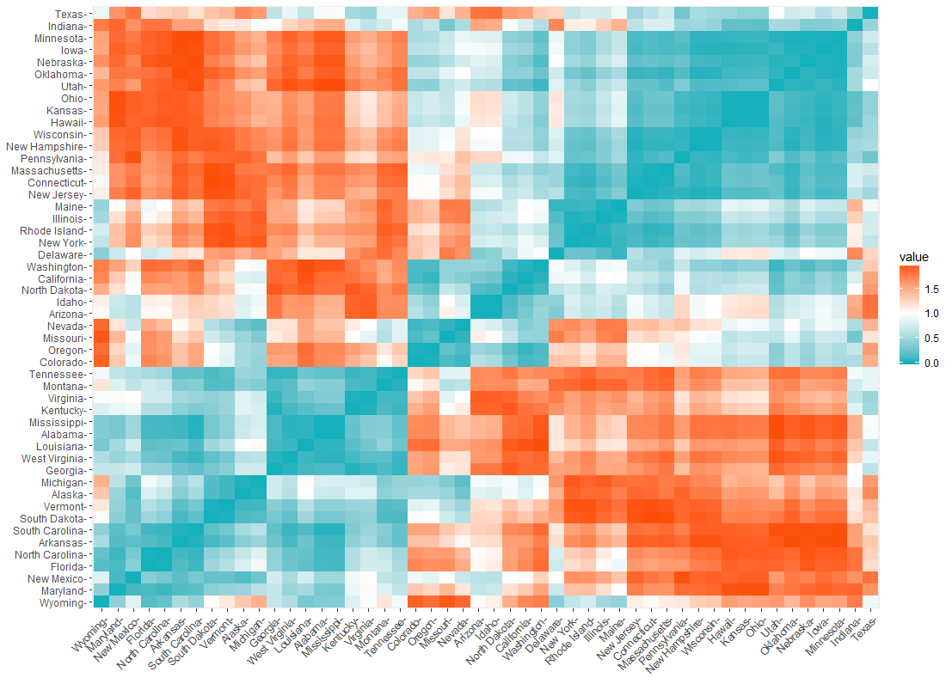

Slide 8
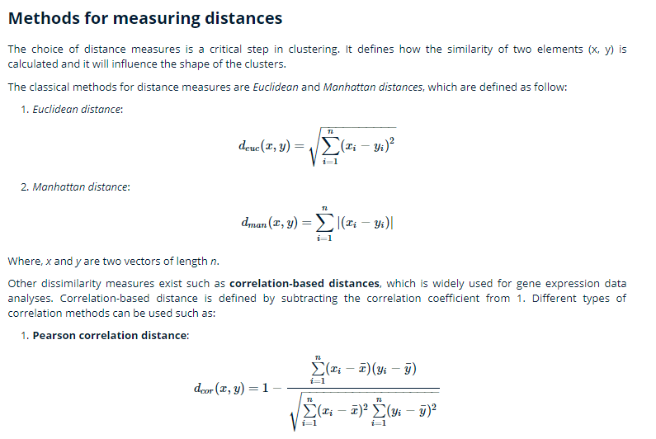

Slide 9
Pearson correlation distance:
Eisen cosine correlation distance
Spearman correlation distance:
Kendall correlation distance:

Slide 10
Partitioning clustering
library("factoextra")
fviz_nbclust(my_data, kmeans, method = "gap_stat")

Slide 11
set.seed(123)
km.res <- kmeans(my_data, 3, nstart = 25)
# Visualize
library("factoextra")
fviz_cluster(km.res, data = my_data,
ellipse.type = "convex",
palette = "jco",
ggtheme = theme_minimal())

Slide 12
# Compute PAM
library("cluster")
pam.res <- pam(my_data, 3)
# Visualize
fviz_cluster(pam.res)

Slide 13
Hierarchical clustering
# Compute hierarchical clustering
res.hc <- USArrests %>%
scale() %>% # Scale the data
dist(method = "euclidean") %>% # Compute dissimilarity matrix
hclust(method = "ward.D2") # Compute hierachical clustering
# Visualize using factoextra
# Cut in 4 groups and color by groups
fviz_dend(res.hc, k = 4, # Cut in four groups
cex = 0.5, # label size
k_colors = c("#2E9FDF", "#00AFBB", "#E7B800", "#FC4E07"),
color_labels_by_k = TRUE, # color labels by groups
rect = TRUE # Add rectangle around groups
)

